Slide 1
Web Application Testing Bitdefender
Final Project
Cursant: Mihai Vasilca

Slide 2
App Description
Bitdefender Central
Web and Desktop Application
Cybersecurity and Antivirus

Slide 3
Testing Approach
Ad-hoc Testing to decide if the application has enough errors.
Smoke Testing for main functionalities
Exploratory Testing for simultaneous learning.
Focus on services that have more bugs than the others.
Write the test and execute them.

Slide 4
Tools Used
Test Link – Test Case Management
Mantis Bug Tracker – Bug Reporting
Snipping Tool – Screenshots
X-Mind – Approach Map

Slide 5
Testing Types
Functional Testing
Exploratory Testing
Positive Testing
Negative Testing
Smoke Testing
UI Testing
UX Testing
Localization Testing
Performance Testing

Slide 6
Bugs Overview

Slide 7
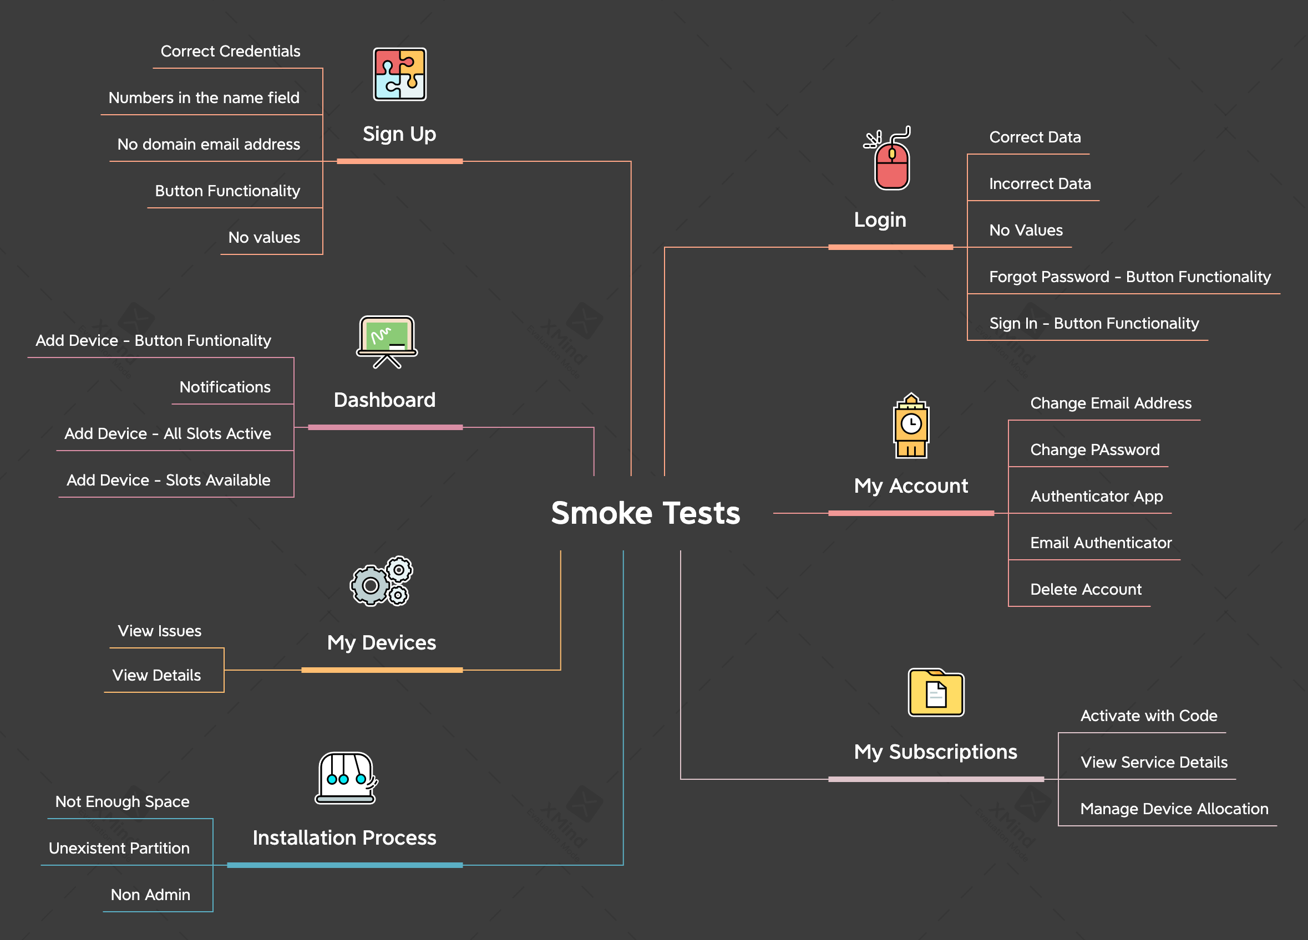
Test Cases Overview

Slide 8
Funtionality | Total | Passed | Failed | Blocked | Not Run | Defects
Sign Up | 8 | 8 | 0 | 0 | 0 | 1
Login | 5 | 5 | 0 | 0 | 0 | 0
My Account | 5 | 5 | 0 | 0 | 0 | 0
Dashboard | 4 | 3 | 1 | 0 | 0 | 1
My Devices | 2 | 2 | 0 | 0 | 0 | 0
My Subscriptions | 3 | 2 | 1 | 0 | 0 | 1
Installation Process | 3 | 3 | 0 | 0 | 0 | 0

Slide 9
Conclsuions
41 Test Cases have been executed in total: 31 passed, and 10 failed
8 Bugs have been identified: 7 major and 1 normal
Ui, Localization and Exploratory Testing were key assets in observing them
Fixing all major bugs is highly recommended

Slide 10
Lessons Learned
Finding an app from a major company worth testing was a challenge.
Lack of knowledge about the environment.
Simultaneously documenting the bugs was a key decision.
Focus on main functionalities, rather than testing types.
Act as a user, not as a tester, so you can fully understand the product.
Go beyond and above in some scenarios.

Slide 11
Thank you!
Any recommendations would be highly appreciated.
Also, I want to thank Scoala Informala de IT for the opportunity.

